Slide 1
Catia design tables
20° and 14.5° Pressure angle gears

Slide 2
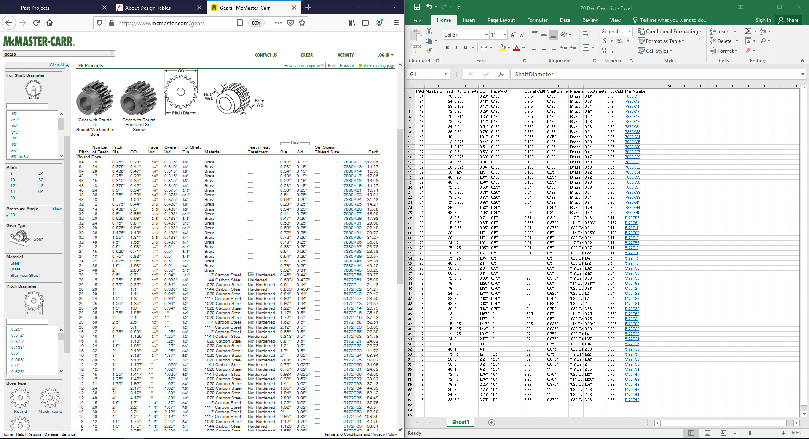
20° Pressure angle Gears

Slide 3
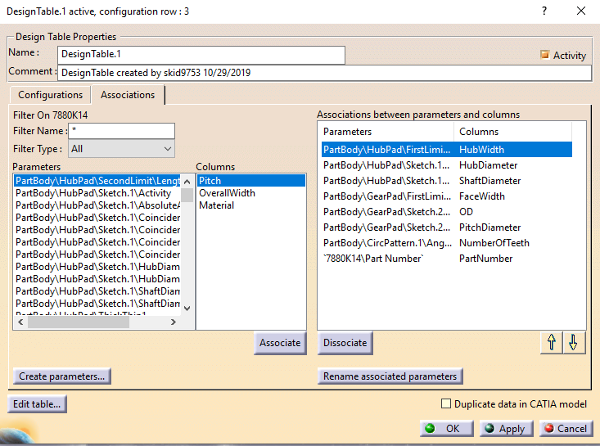
20° Pressure angle Gears
Issues encountered
Incorrect Associations
Despite assuring that dimensions in CATIA match Column headers manual association is required.
Dimensions in inches (“)
At first I removed the inch (“) from design table, resulting in exploded part, maintain (“) in table.
3-Decimal Maximum
Converting fractions to decimals resulted in 4 decimal places in Excel, had to round to 3 decimals for CATIA requirement.

Slide 4
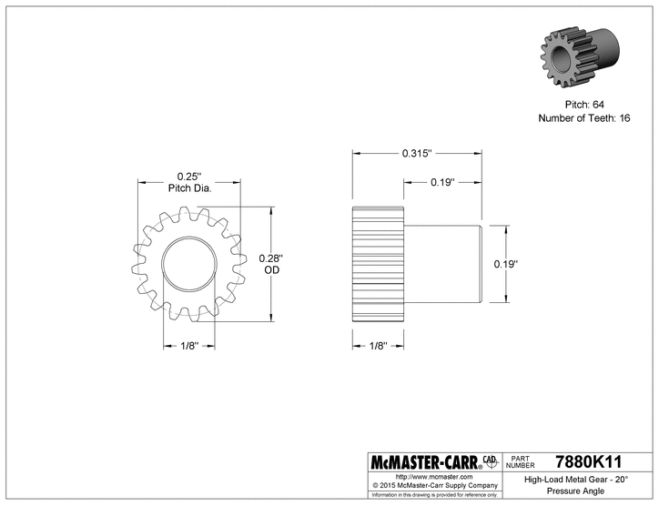
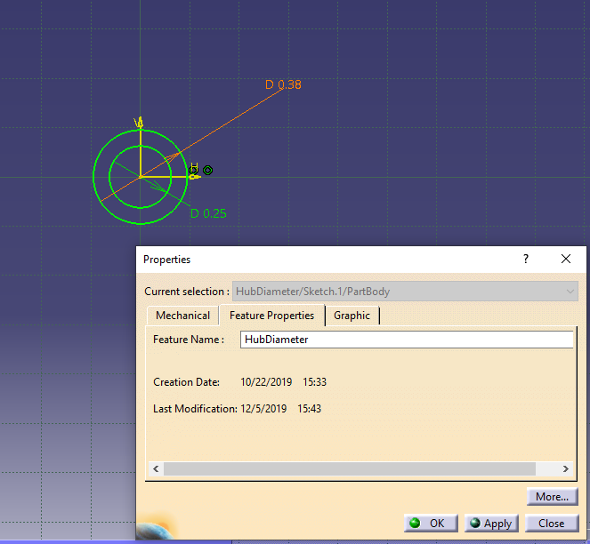
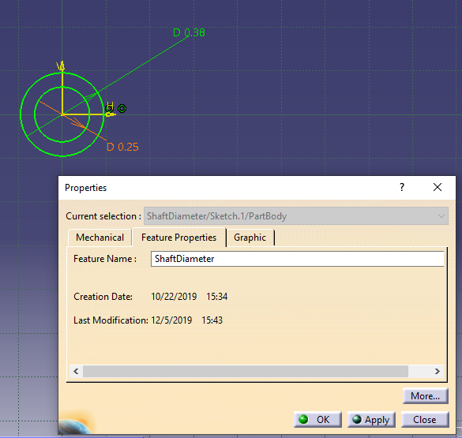
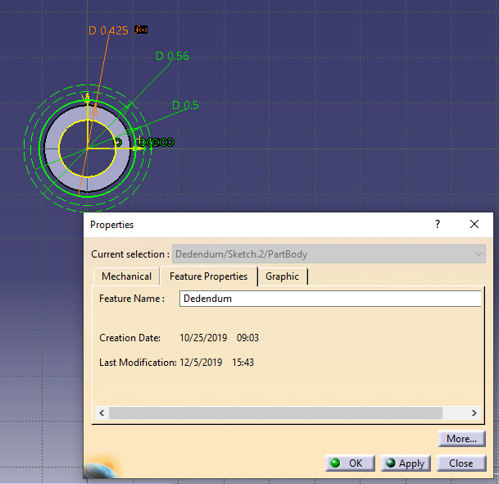
20° Pressure angle Gears
Design Process
Initial Sketches
The initial sketches were easily produced as they were initial built from a McMaster-Carr Part Drawing.
Named Dimensions
After creating the dimensions I named them specific and identifiable names in their properties so that I could easily associate them to the design table later.

Slide 5
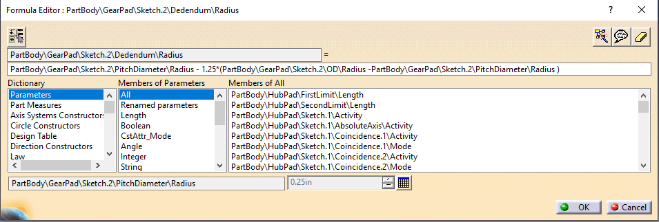
20° Pressure angle Gears
Design Process
Gear Formulas
Modeling Involute gears is very difficult, using equations from Cameron Stefanic’s Masters thesis I was able to create simplified formulas to generate gear shapes.

Slide 6
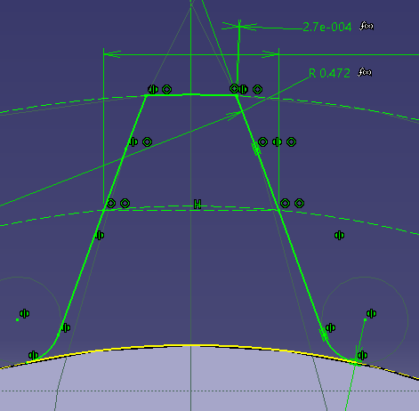
20° Pressure angle Gears
Design Process
Gear Sketches
The sketch of the gear teeth is determined from the previous formulas allowing for the design table to change key dimensions and update all aspects of the teeth.

Slide 7
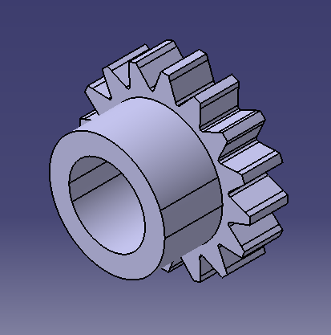
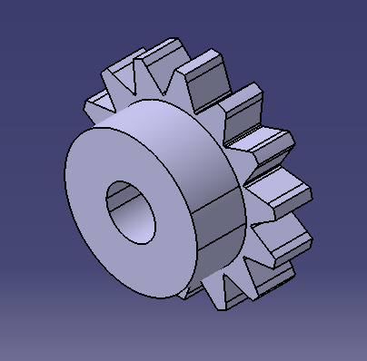
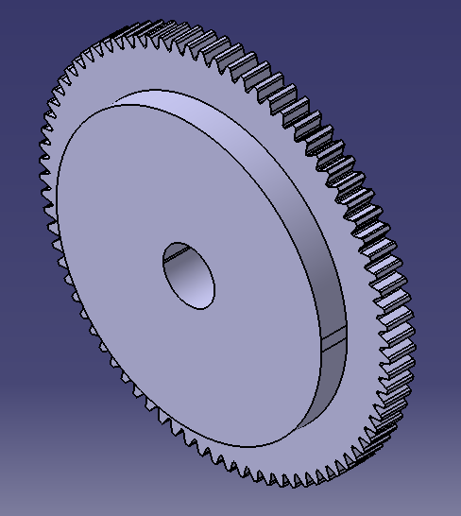
20° Pressure angle Gears
Final Designs

Slide 8
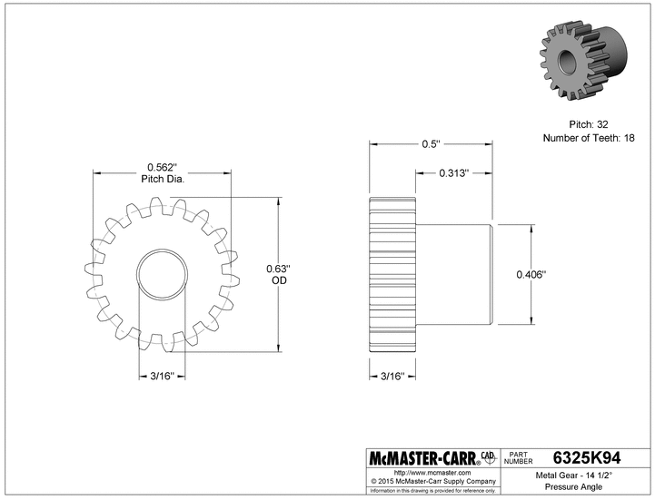
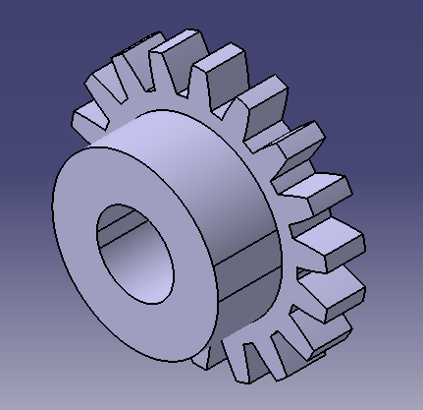
14.5° Pressure angle Gears
Issues encountered
Gear Teeth Drawing
The change of the gear angle broke the relations of the teeth geometry, updated sketch to include curved radius to match McMaster-Carr

Slide 9
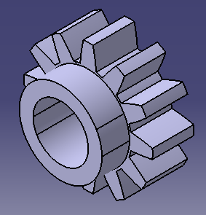
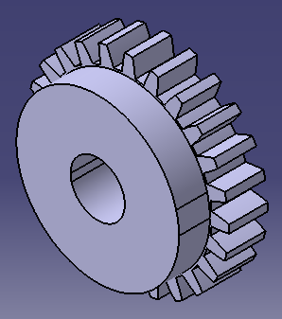
14.5° Pressure angle Gears
Final Designs

